Slide 1
Asymmetric Encryption
By Rafael Simioni

Slide 2

What is asymmetric encryption?
Encryption that uses keys to encrypt something
Can be used to encrypt anything from another key to files
Pair of keys usually called the “public” and “private” pair

Slide 3

History of asymmetric encryption
Asymmetric encryption has been around for a while
Invented during the mid-1970s by a British cryptographer called James H. Ellis
His colleague, Clifford Cocks, created the first iteration called RSA in 1973, which is still in use today
This Photo by Unknown Author is licensed under CC BY-SA

Slide 4
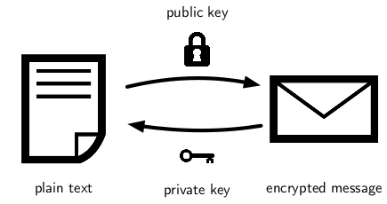
How does it work?
Content is encrypted with a public key that can be known by anyone
The content can only be decrypted with a non-public private key
This Photo by Unknown Author is licensed under CC BY-SA

Slide 5

What types are there?
There are various commonly used types today
RSA (Rivest Shamir Adleman)
EdDSA (Edwards-curve Digital Signature Algorithm)
ECC (Elliptical Curve Cryoptography)
This Photo by Unknown Author is licensed under CC BY-SA

Slide 6
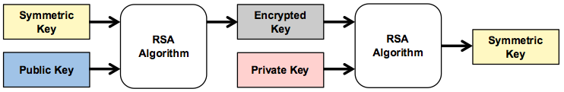
Mixed used of asymmetric and symmetric
It is common to see asymmetric and symmetric mixed together
SSH uses asymmetric keys to encrypt a symmetric key
HTTPS uses asymmetric keys to encrypt symmetric session keys
This Photo by Unknown Author is licensed under CC BY

Slide 7

Some real-world examples
All these examples use some form of a public/private key pair
SSH key pairs (most commonly with RSA and EdDSA)
PGP
HTTP TLS/SSL

Slide 8
Sources
https://www.cloudflare.com/learning/ssl/how-does-public-key-encryption-work/
https://cheapsslsecurity.com/blog/what-is-asymmetric-encryption-understand-with-simple-examples
https://ghostvolt.com/articles/cryptography_20th_centuary.html
https://www.trentonsystems.com/blog/symmetric-vs-asymmetric-encryption

